Slide 1


BLUE FINANCE
AUTHOR: KHUSHBOO ASHRA

Slide 2
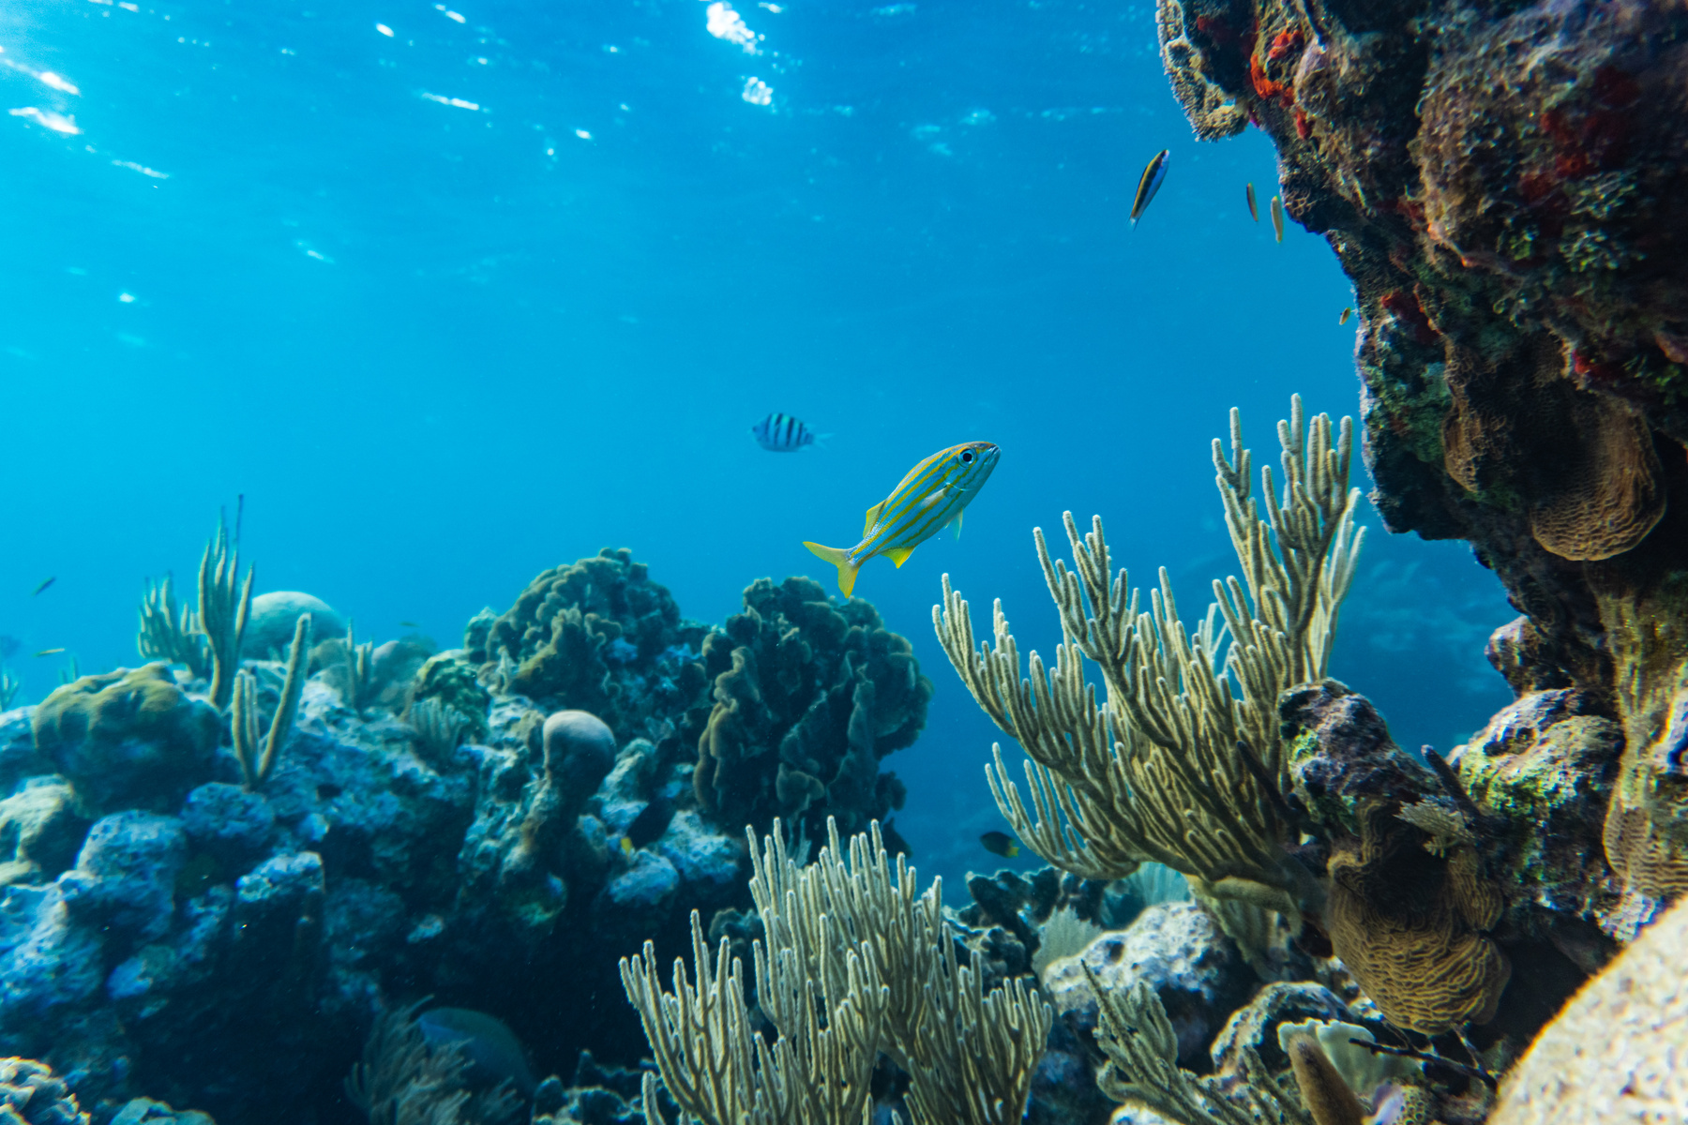
WHAT IS BLUE FINANCE?
Blue Finance refers to the use of financial instruments for promoting sustainable use of marine resources and conservation of the ocean. It aim at safeguarding the water resources and our access to it. It falls under the broader concept of the "blue economy," which seeks to balance economic growth with the preservation of ocean ecosystems

Slide 3
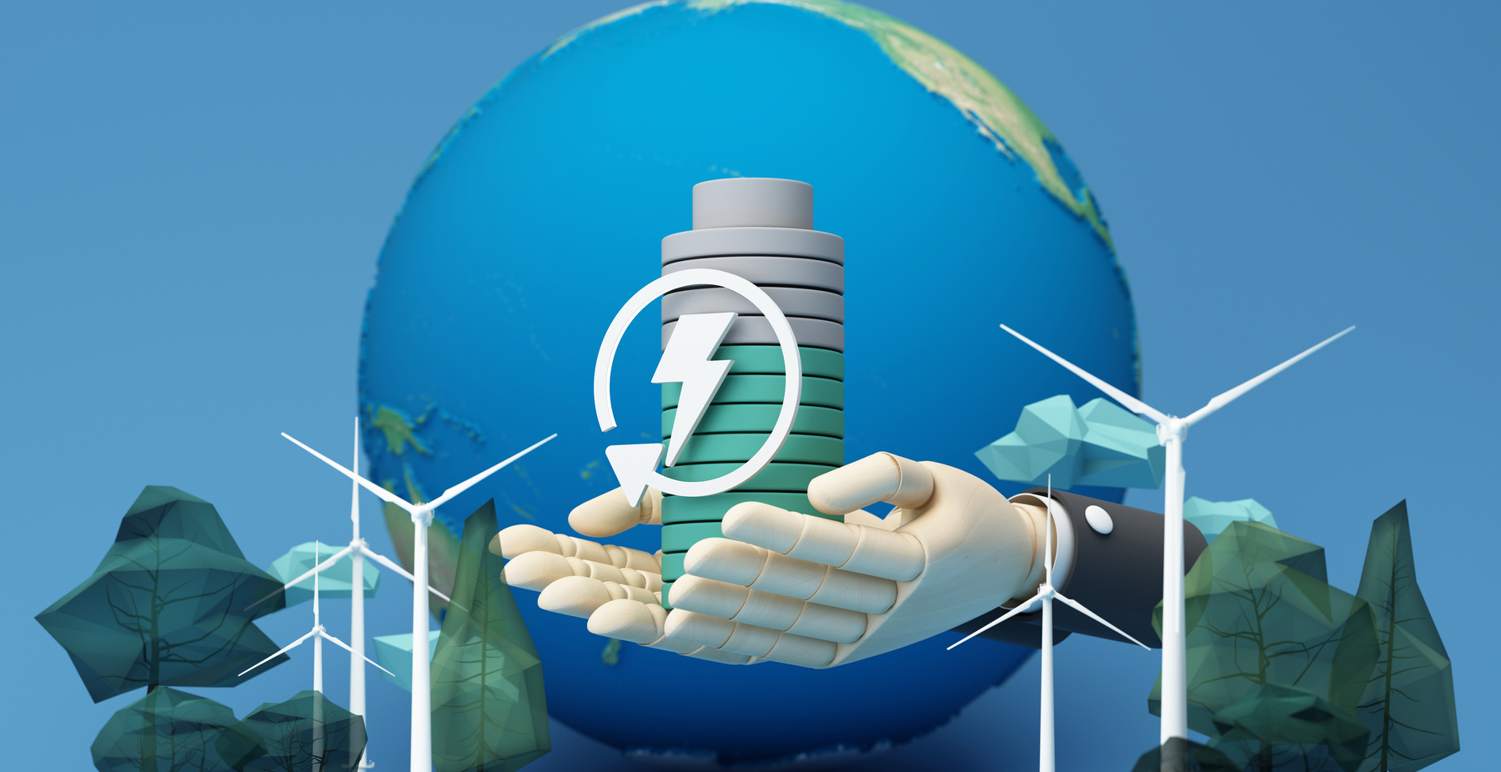
ACTIVITIES INCULCATED IN BLUE FINANCE
  Sustainable fisheries and aquaculture: Ensuring fishing practices are sustainable and that marine ecosystems remain healthy.
  Marine conservation: Protecting coral reefs, mangroves, and other vital marine habitats.
  Renewable marine energy: Investing in offshore wind, tidal, and wave energy.
  Sustainable tourism: Developing tourism that minimizes environmental impact on coastal and marine areas.
  Pollution control: Addressing ocean plastic pollution, oil spills, and other harmful substances affecting marine life.

Slide 4
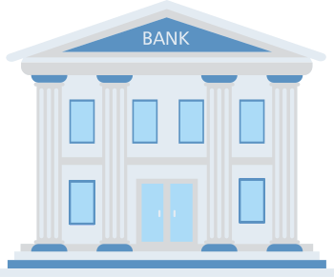
BLUE BONDS AND BLUE LOANS
Blue finance is a sub-part of “Climate finance” which is a result of global efforts towards tackling climate change. The United Nations and World Bank are two of the major players behind its development.
Blue bonds and blue loans are the two kinds of financial instruments that are being used by countries to encourage blue finance.

Slide 5
DEVELOPMENTS
  International Finance Corporation (IFC) started its initiatives related to blue finance in 2020 by issuing more than $1.9 billion blue bonds and loans to different institutions.
  The first blue bond was issued by BDO Unibank Inc. in the Philippines to control the issue of marine plastics. Many other countries including Thailand, some Latin American countries and Dubai have also followed suit.
  Although blue bonds are still emerging in the countries, the concept is gaining traction as countries become more aware of the importance of protecting marine ecosystems while pursuing economic development. However, challenges include developing the necessary financial infrastructure and ensuring that blue bond projects meet global sustainability standards.
Source: ifc.org, compiled by author

